Slide 1
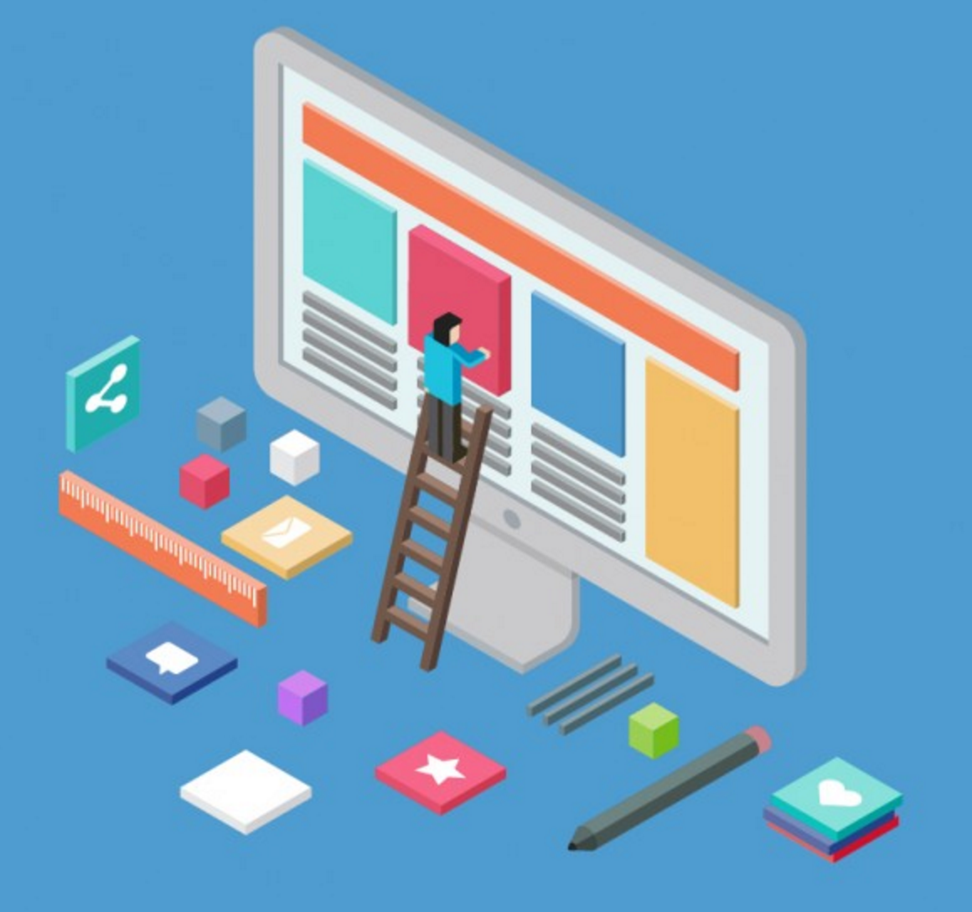
FRONT-END
WEB DEVELOPMENT

Slide 2


Introduction to Frameworks

Slide 3

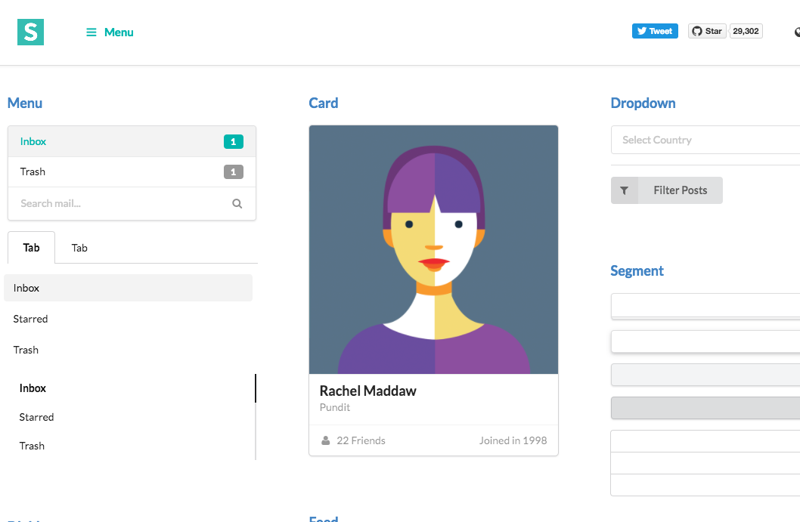
So, What’s framework?
What is framework?
A framework is defined as a package made up of a structure of files and folders of standardized code (HTML, CSS, JS ,etc.),
which can be used to support the development of websites, as a basis to start building a site.
Most websites share a very similar (not to say identical) structure. The aim of frameworks is to provide a common structure so that developers don’t have to redo it from scratch and can reuse the code provided. In this way, frameworks allow us to cut out much of the work and save a lot of time.

Slide 4
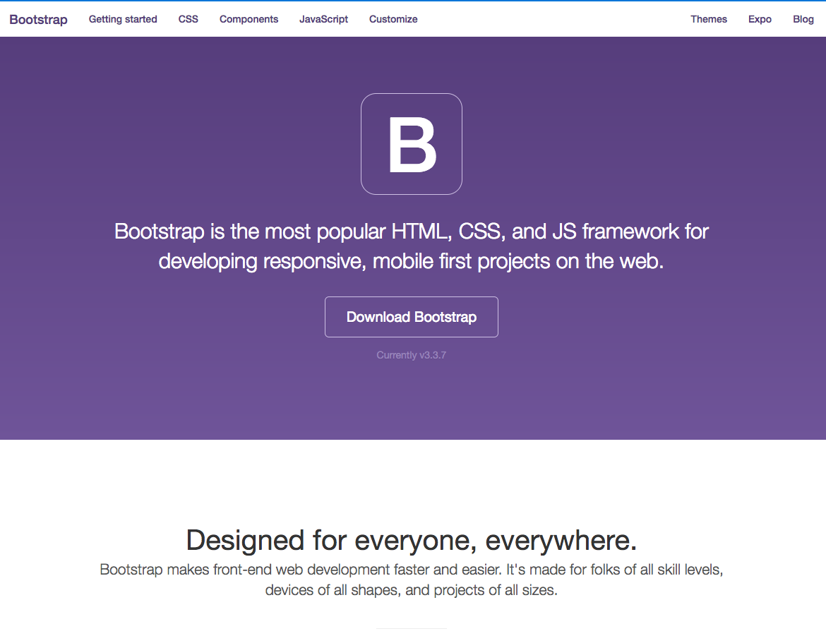
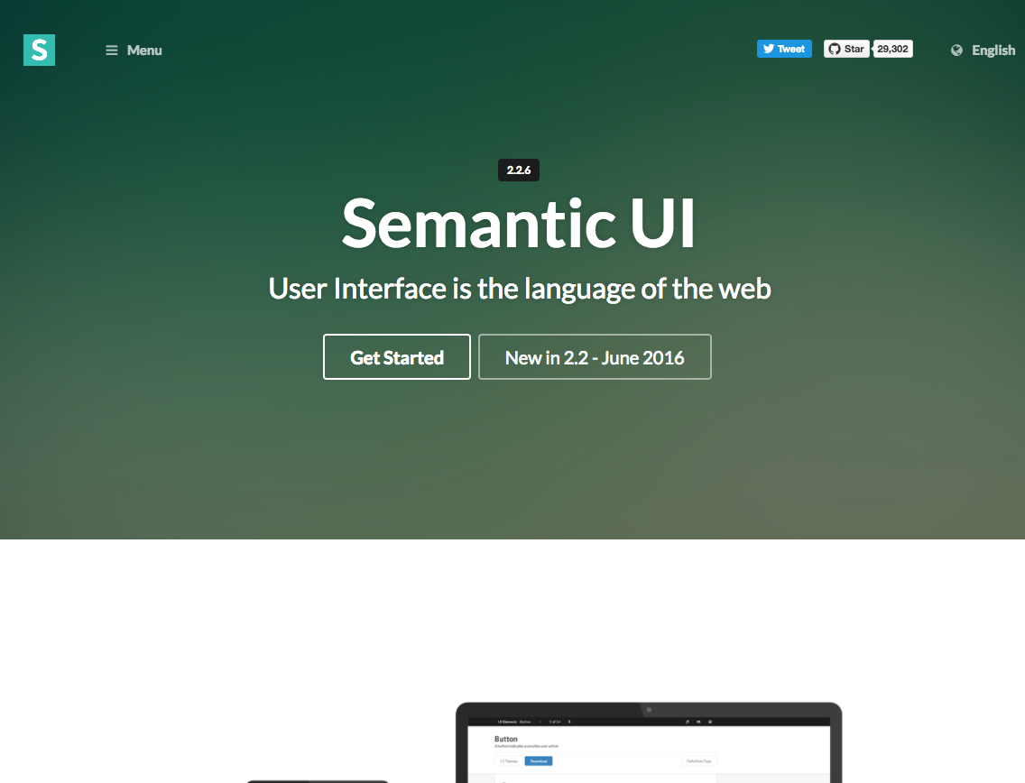
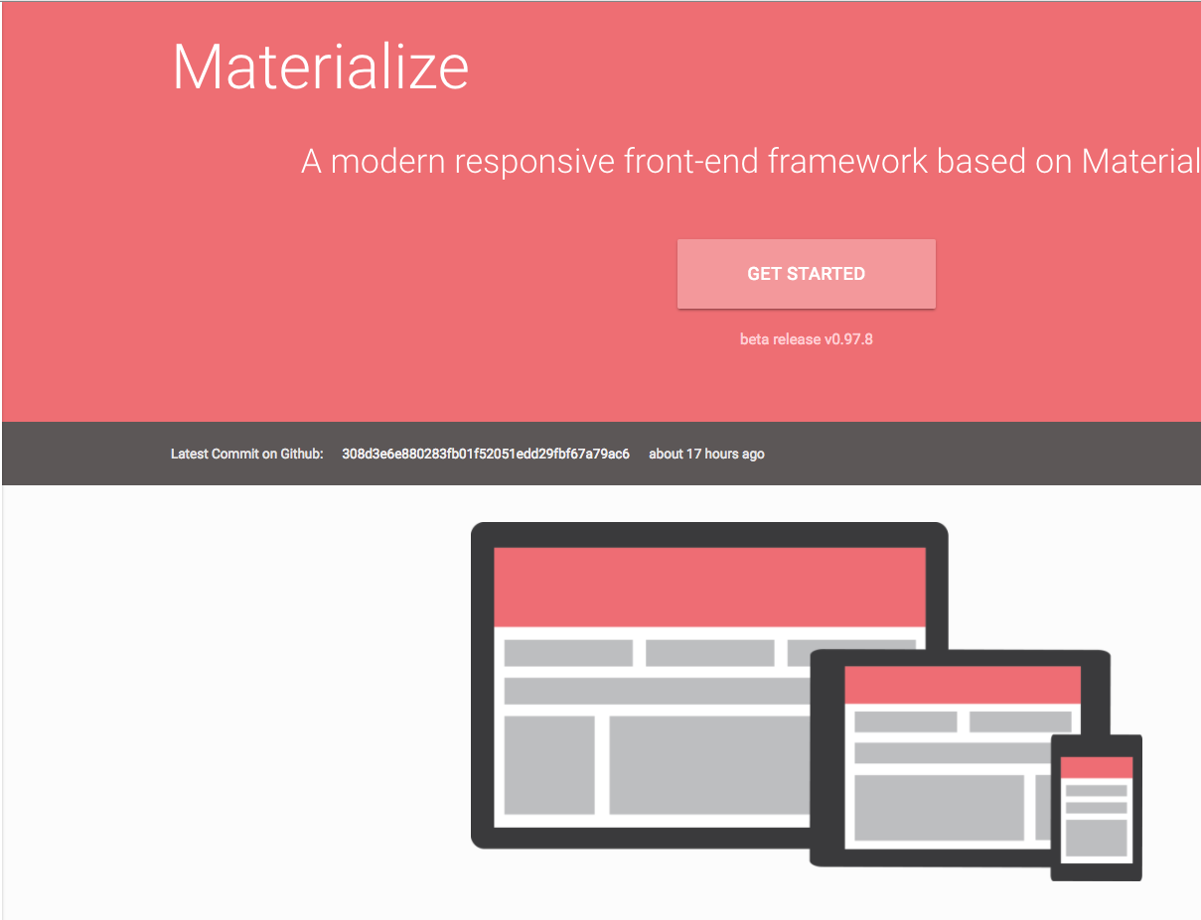
So, What’s framework?
Which framework?
Choosing a framework is not a critical point, as long as it fills the requirements of your website.
But don’t choose more than one in your website to prevent overriding classes and ids.

Slide 5
So, What’s framework?
Which framework?
There are many framework out there, such as:
Semantic UI
Bootstrap
Foundation
Materialize
Pure.css
Material-UI
Skeleton
…
And many more..

Slide 6

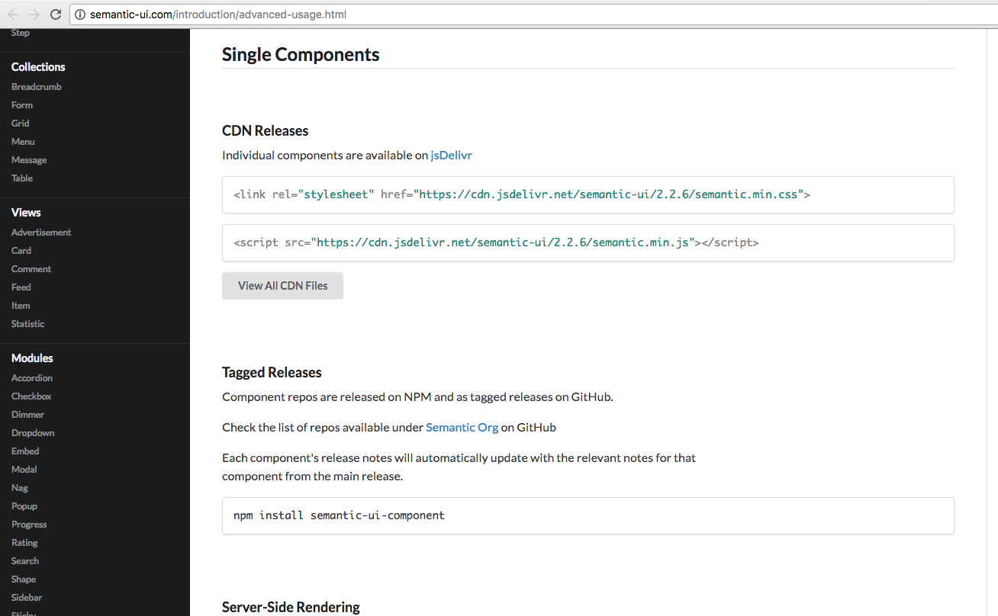
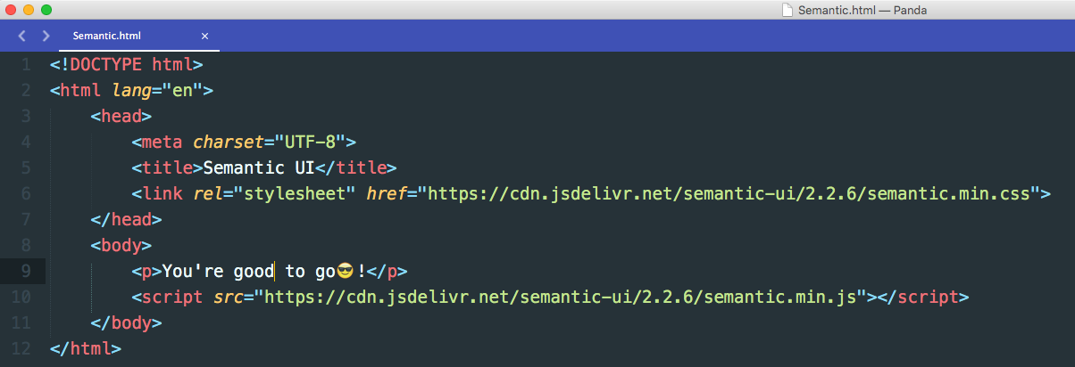
So, What’s framework?
How to include framework in my website?
There are two ways:
Using CDN* and link the CSS & JS files directly without download them.
Download the files and include them manually in the same directory of you project (preferred for local development) * A content delivery network (CDN) is a system of distributed servers (network) that deliver webpages and other Web content to a user based on the geographic locations of the user, the origin of the webpage and a content delivery server.

Slide 7

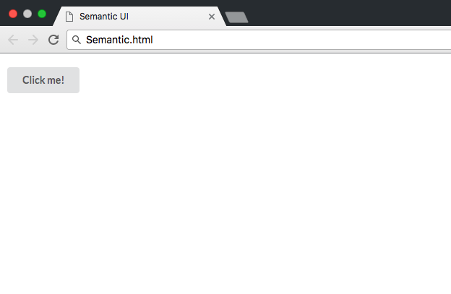
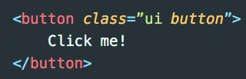
So, What’s framework?
Let’s discover it 😇!
Adding buttons to your website becomes extremely easy, just like that:

Slide 8
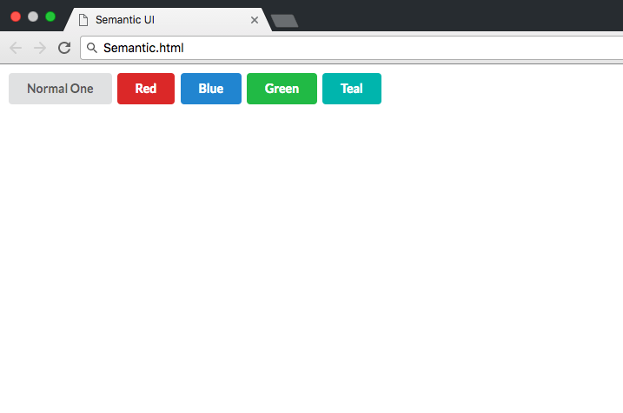
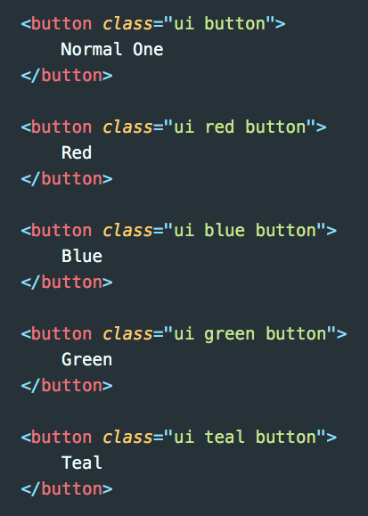
Let’s discover it 😇!
So, What’s framework?
You can choose from various available colors, just by adding the name of the color as extra class!

Slide 9

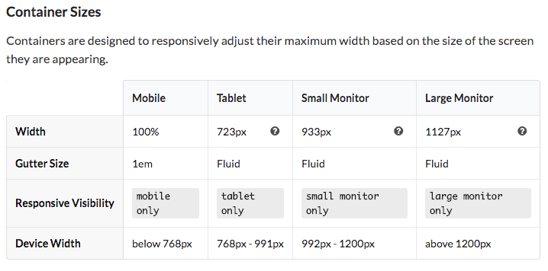
Container
So, What’s framework?
When to use?
A container is an element designed to contain page elements to a reasonable maximum width based on the size of a user's screen.
This is useful to couple with other UI elements like grid or menu to restrict their width to a reasonable size for display.

Slide 10
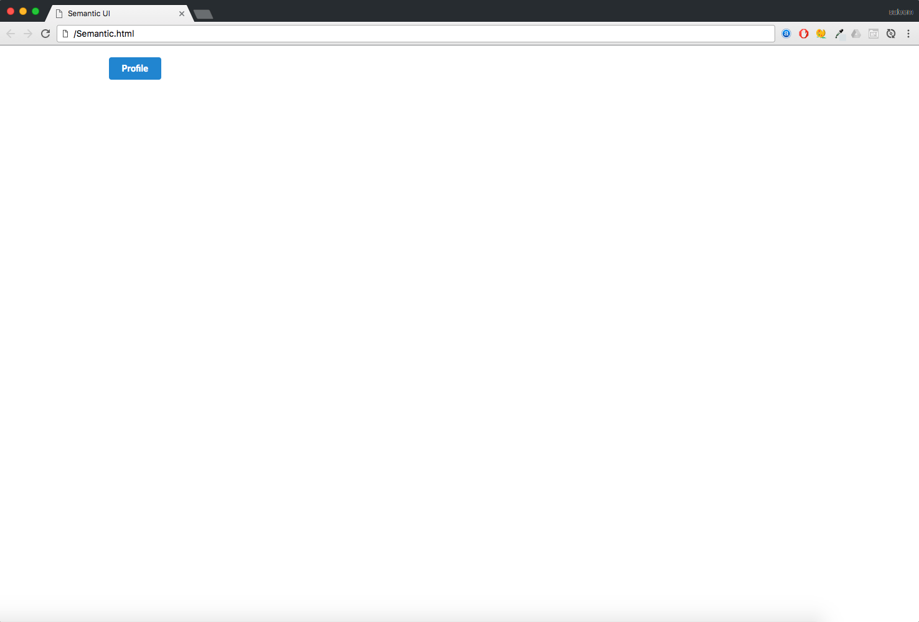
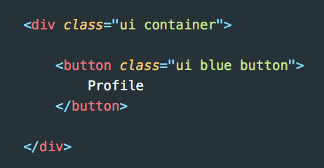
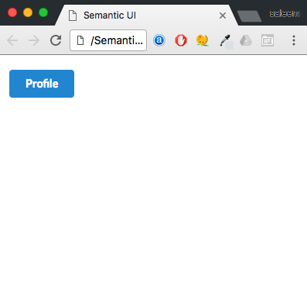
Container
So, What’s framework?
Example:
Big monitor
Mobile screen size

Slide 11

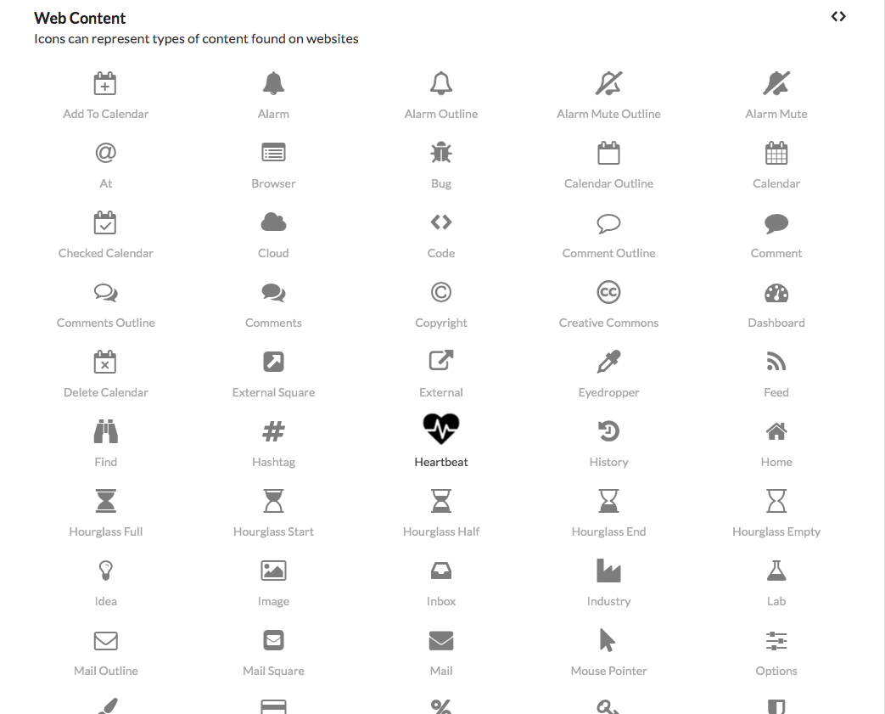
Icons
So, What’s framework?
Icons serve a very similar function to text in a page.
In Semantic icons receive a special tag <i> which allow for an abbreviated markup when sitting along-side text.
You can add icons anywhere you want, i.e. inside div, button, anchor, nav, … etc

Slide 12
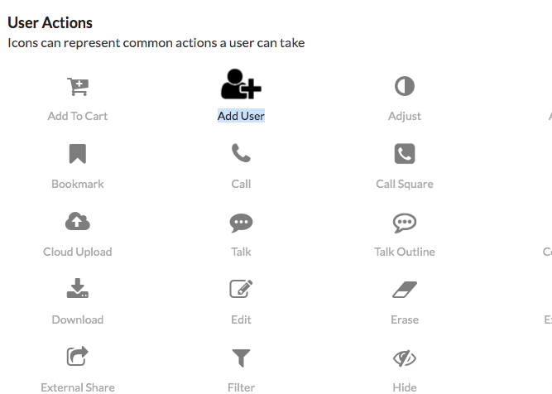
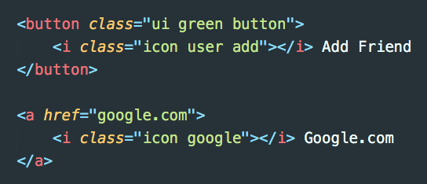
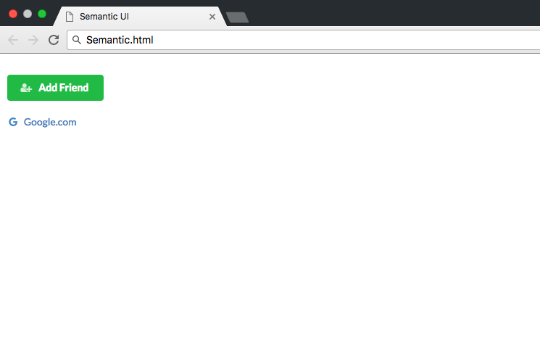
Icons
So, What’s framework?
Example:

Slide 13



Images
So, What’s framework?
Semantic provides many classes to manage and work with images easily.
First if you need to add ui image classes, and then you specify the custom action you want.
Examples:
- you might want to center the image -> centered
- Adding border -> Bordered
- Make it responsive to any width -> Fluid
- To make it circle -> circular
And many more..

Slide 14

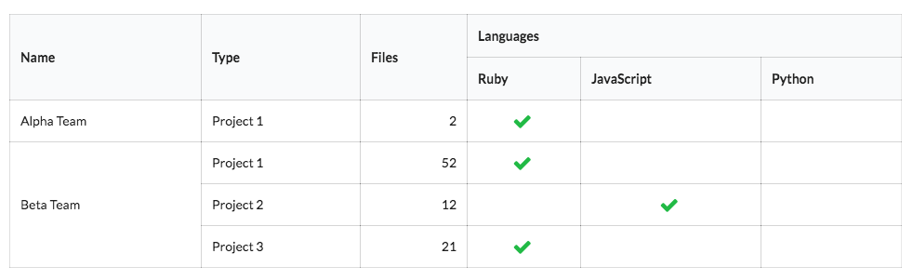
Tables
So, What’s framework?
Tables will automatically stack their layouts for mobile devices.
There are multiple classes you can specify to perform styling on tables, such as:
Changing colors, width, columns, rows… etc
Example, “from semantic website”

Slide 15

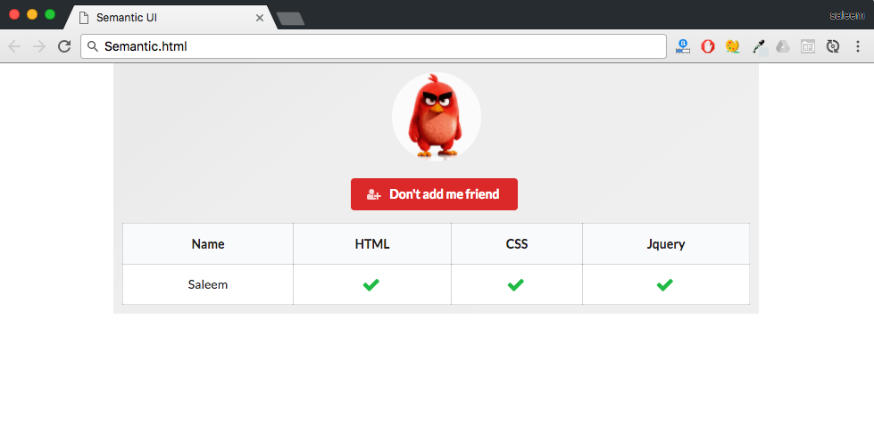
Practice makes perfect!
So, What’s framework?
Simple project:
Try to construct this simple looking web page using what you’ve learned in Semantic UI.
Steps:
Add image and make it circular
Add button below it and style it as you want.
And one table containing two rows and as much columns you want as shown in the example ->

Slide 16

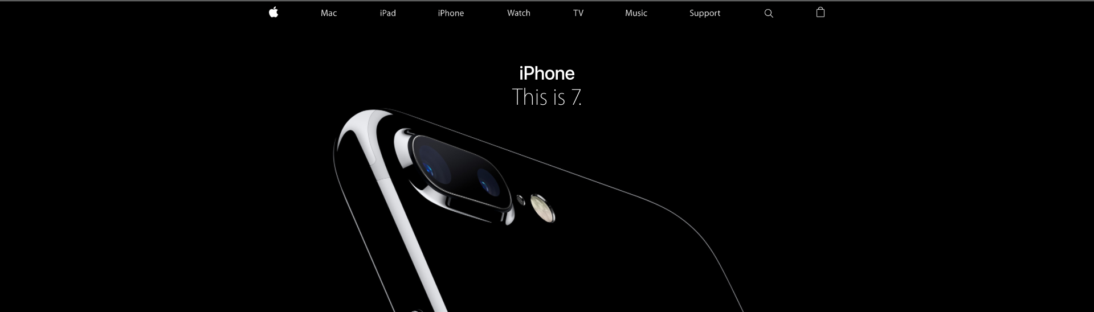
Menus
So, What’s framework?
A menu displays grouped navigation actions, which clearly we can see most of the websites having almost the same kind of menu.
Semantic provides huge amount of menus we can choose, first we should add as you expect ui menu classes

Slide 17
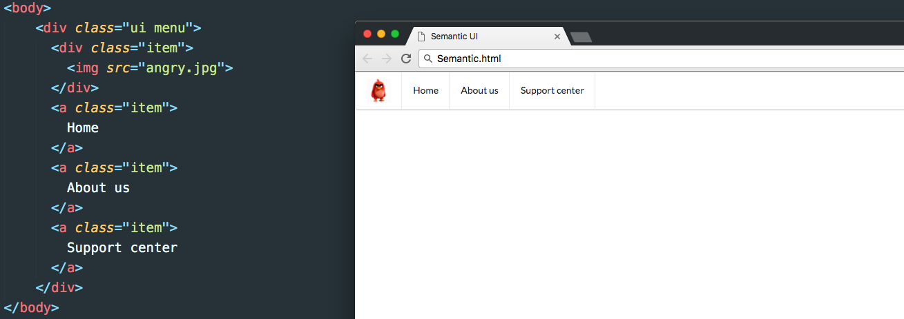
Menus
So, What’s framework?
Example,
Note: to move an item to the right -> add right class, just like that ☺

Slide 18

All semantic elements
http://semantic-ui.com/kitchen-sink.html#/modules

Slide 19

Resources?
What I should learn?

Slide 20

Things to read and understand:
SEO:
https://moz.com/beginners-guide-to-seo
Commands availability:
http://caniuse.com/

Slide 21

Courses and best web development recourses:
Udemy :
https://www.udemy.com/courses/\
CodeAcademy (the best) :
https://www.codecademy.com/
W3school :
http://www.w3schools.com/
Khan academy :
https://www.khanacademy.org/computing/computer-programming/html-js-jquery

Slide 22
? Who you should ask?
google :
https://www.google.com
stackoverflow
http://stackoverflow.com/

Slide 23

Best Youtube channels
Devtips (the best for font-end):
https://www.youtube.com/user/DevTipsForDesigners/playlists
Codecourses (the best for backend):
https://www.youtube.com/user/phpacademy
Minespace:
https://www.youtube.com/channel/UCSJbGtTlrDami-tDGPUV9-w

Slide 24
Colors and design inspiration:
https://flatuicolors.com/
https://dribbble.com/
https://www.pinterest.com/
https://www.behance.net/
Open source graphic design:
http://www.flaticon.com/
http://www.freepik.com/free-photos-vectors/free-vector-monster
https://fonts.google.com/
Other helpful website:
https://www.iconfinder.com/

Slide 25
Better text editor:
Sublime:
https://www.sublimetext.com/
Phpstorm:
https://www.jetbrains.com/phpstorm/
What you should learn after now?
Sass, Scss, gulp
https://www.codecademy.com/
Angularjs
https://www.codecademy.com/
https://www.youtube.com/watch?v=NJ4FYsRV3nU&list=PLLnpHn493BHF6utwkwpo7RN-GPg1sZhvK
https://www.youtube.com/watch?v=d6Dp4Dyeke8&list=PL55RiY5tL51olfU2IEqr455EYLkrhmh3n
Git and github:
https://www.codecademy.com/
https://www.youtube.com/watch?v=DR7MLaAKcUk&list=PLfdtiltiRHWFEbt9V04NrbmksLV4Pdf3j
Command line tools:
https://www.codecademy.com/

